Slide 1
Chapter 13
File
Structures

Slide 2
OBJECTIVES
After reading this chapter, the reader should
be able to:
Understand the file access methods.
Describe the characteristics of a sequential file.
Describe the characteristics of an indexed file.
Describe the characteristics of a hashed file.
Distinguish between a text file and a binary file.

Slide 3
13.1
ACCESS
METHODS

Slide 4
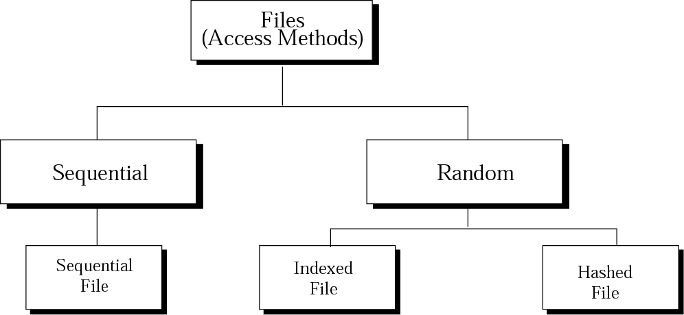
Figure 13-1
Taxonomy of file structures

Slide 5
13.2
SEQUENTIAL
FILES

Slide 6
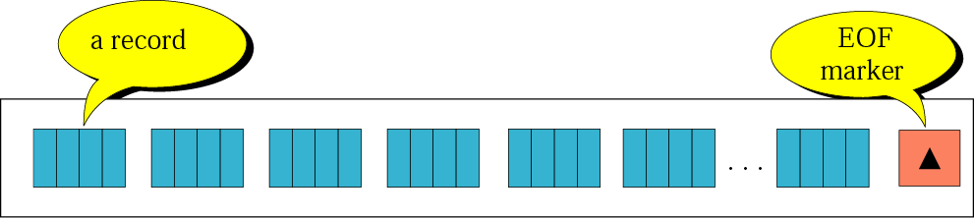
Figure 13-2
Sequential file

Slide 7
Program 13.1
Processing records in a sequential file
While Not EOF
{
Read the next record
Process the record
}

Slide 8
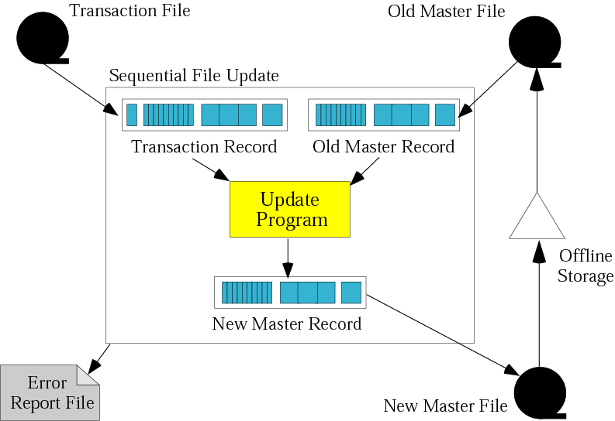
Figure 13-3
Updating a sequential file

Slide 9
13.3
INDEXED
FILES

Slide 10
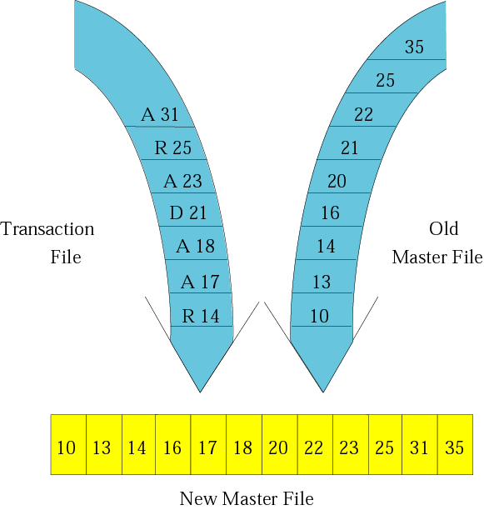
Figure 13-4
Updating process

Slide 11
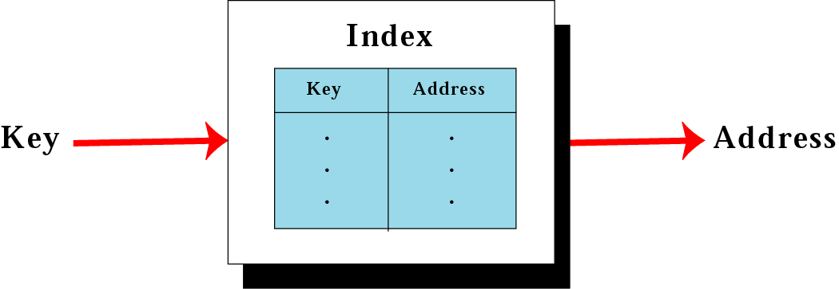
Figure 13-5
Mapping in an indexed file

Slide 12
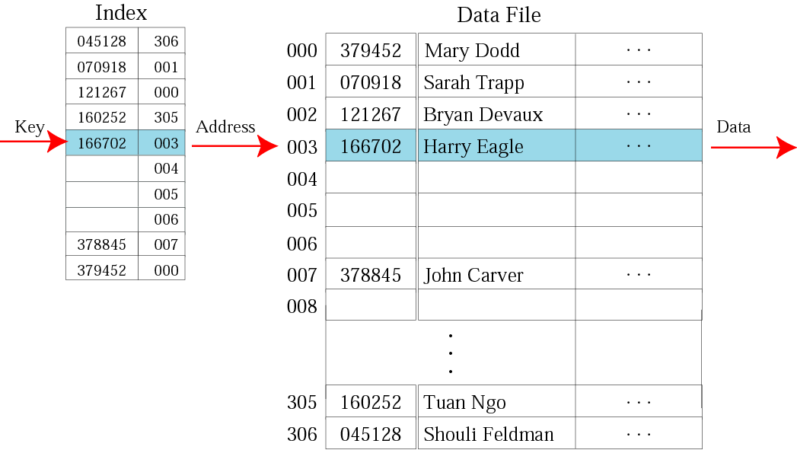
Figure 13-6
Logical view of an indexed file

Slide 13
13.4
HASHED
FILES

Slide 14
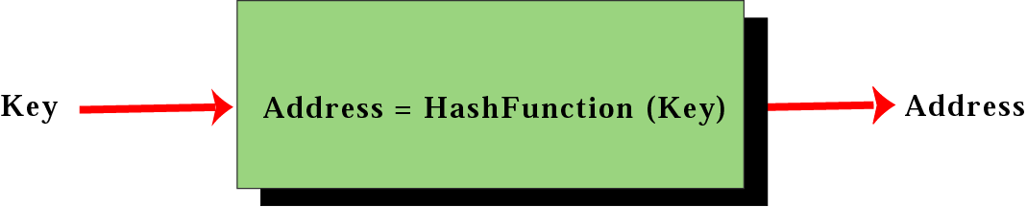
Figure 13-7
Mapping in a hashed file

Slide 15
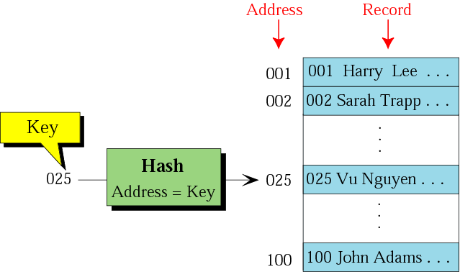
Figure 13-8
Direct hashing

Slide 16
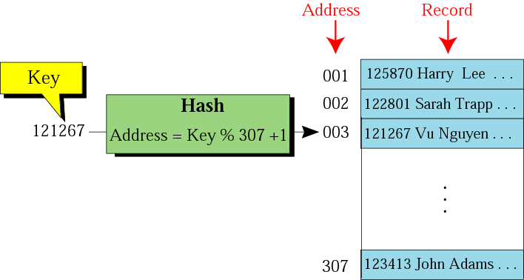
Figure 13-9
Modulo division

Slide 17
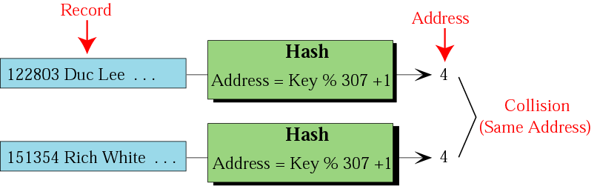
Figure 13-10
Collision

Slide 18
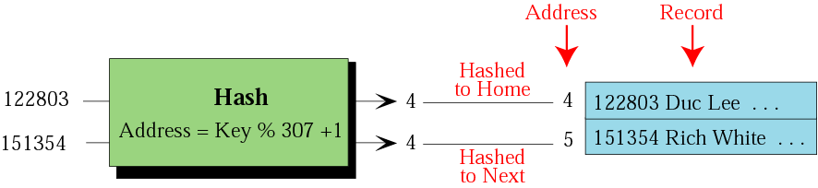
Figure 13-11
Open addressing resolution

Slide 19
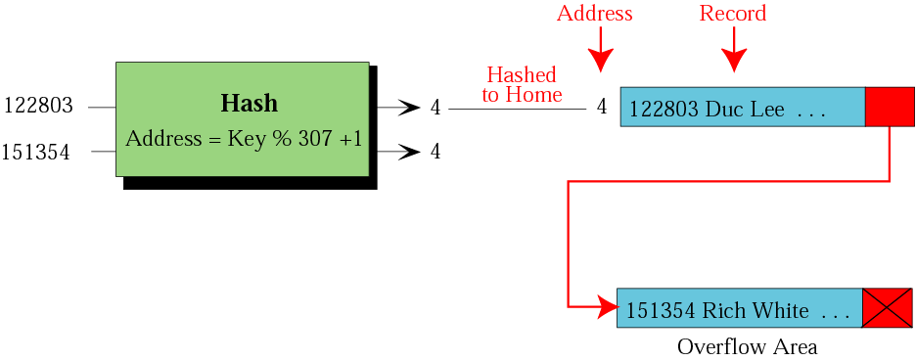
Figure 13-12
Linked list resolution

Slide 20
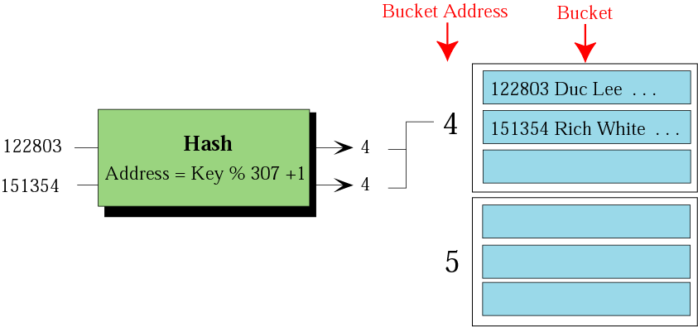
Figure 13-13
Bucket hashing resolution

Slide 21
13.5
TEXT
VERSUS
BINARY

Slide 22
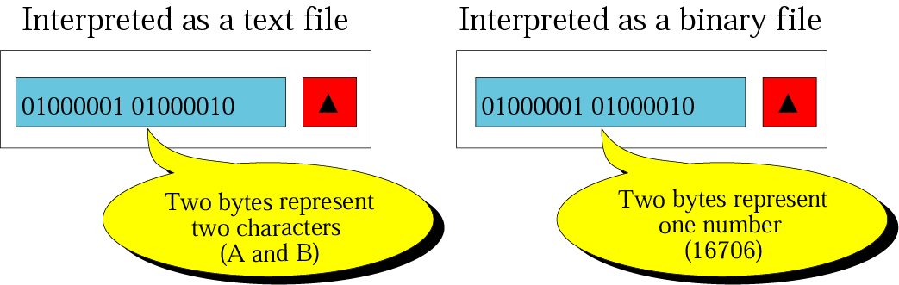
Figure 13-14
Text and binary interpretations of a file

